Slide 1

Introduce To

Slide 2
Why GIT is Useful
?

Slide 3
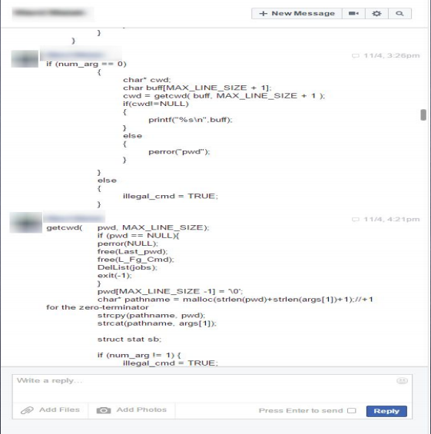
Use Case

Slide 4
Fork
menyalin

Slide 5
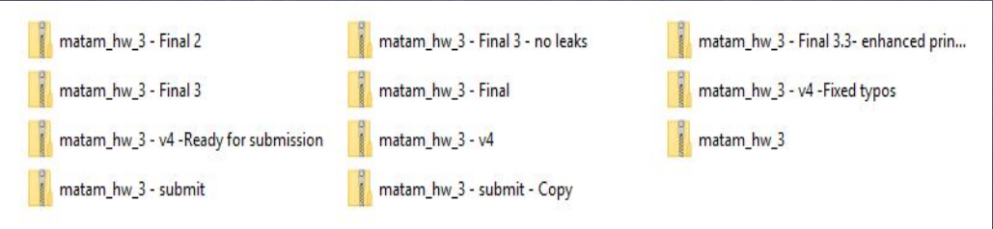
Use Cases

Slide 6
Use Cases
Consider this scenario:
You have a homework submission in Matam for today and the assignment is ready for submission
While testing it you discovered a minor bug and decided to fix it

Slide 7
Use cases
After attempting to do so, you accidentally changed a working code and got yourself in a big mess
You no longer remember what was and what wasn’t there
It is 23:58 PM

Slide 8
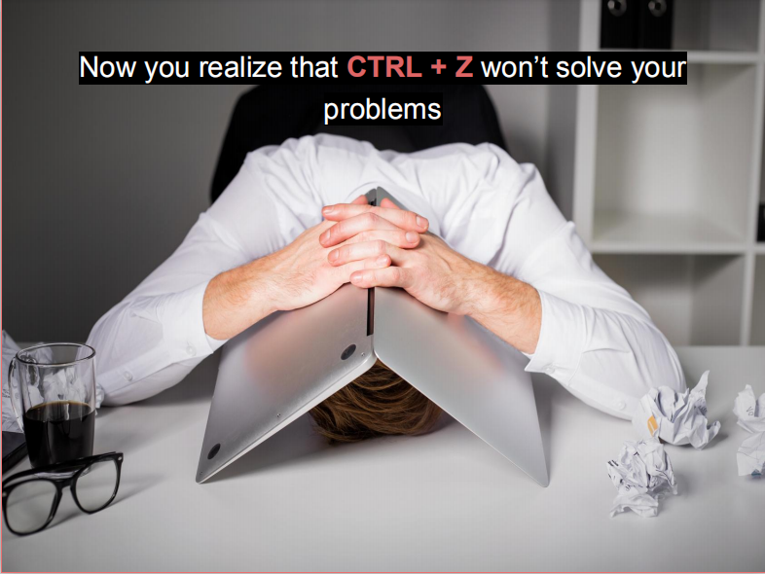

Slide 9
What is git?

Slide 10
What is git?
Open source project originally developed in 2005 by Linus Torvalds
A command line utility
You can imagine git as something that your file system and manipulates files
A distributed version control system - DCVS

Slide 11
What is “distributed version control system” ?
Version control system is a system that records changes to a file or set of files over time so that you can recall specific versions later
Distributed means that there is no main server and all of the full history of the project is available once you cloned the project

Slide 12
A brief history
In 2002, the Linux kernel project began using a DVCS called BitKeeper
In 2005, the commercial company that developed BitKeeper broke down, and the tool’s free-of-charge status was revoked
This prompted the Linux development community (and in particular Linus Torvalds, the creator of Linux) to develop their own tool - git

Slide 13
Demo

Slide 14
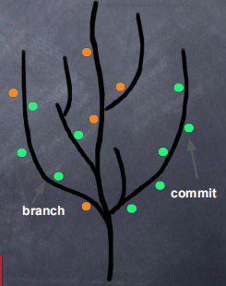
git
You can imagine git as something that sits on top of your file system and manipulates files
This “something” is a tree structure where each commit creates a new node in that tree
Nearly all git commands actually serve to navigate on this tree andto manipulate it accordingly

Slide 15
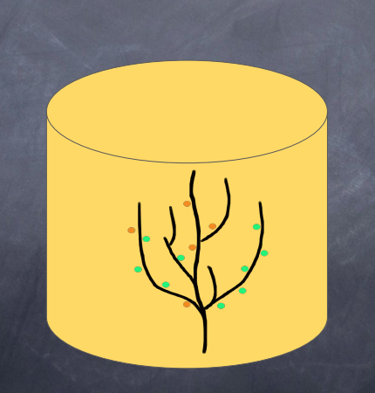
git repository

Slide 16
git repository
The purpose of git is to manage a project, or a set of files, as they change over time. Git stores this information in a data structure called a repository
A git repository contains, mainly:
A set of commits

Slide 17
Commit
A commit object mainly contains three things:
A set of changes the commit introduces
Commit message describing the changes
A hash, a 40-character string that uniquely identifies
the commit object

Slide 18
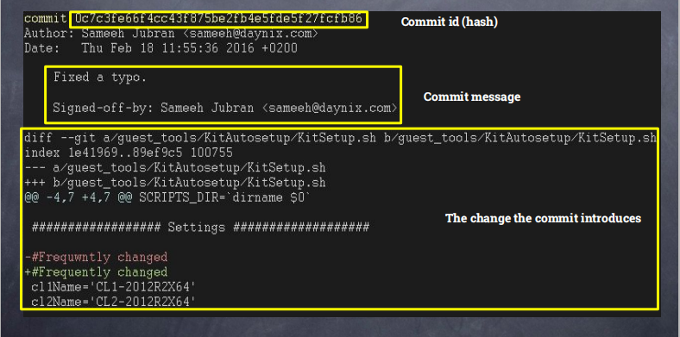
Commit

Slide 19
github

Slide 20
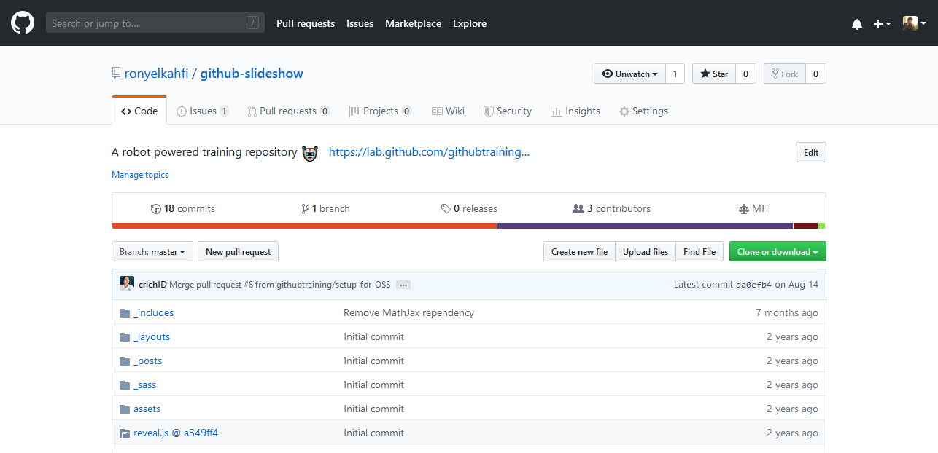
GitHub is a web-based Git repository hosting service

Slide 21
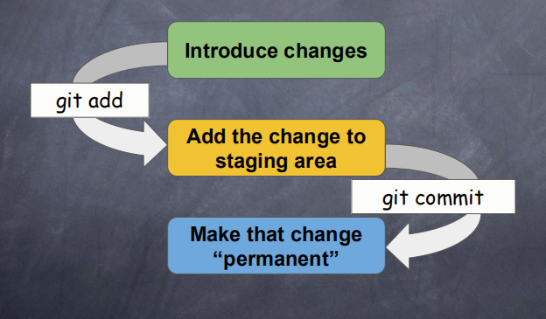
git workflow
How commits are created?

Slide 22
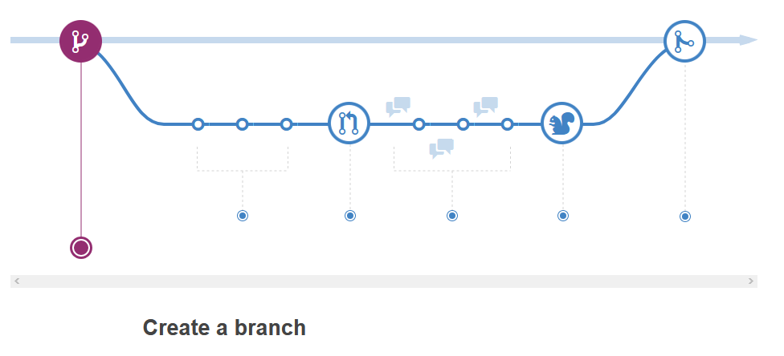
github workflow

Slide 23
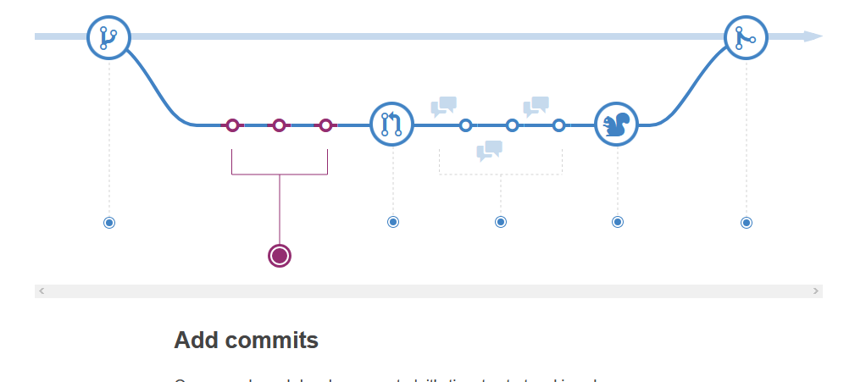
github workflow

Slide 24
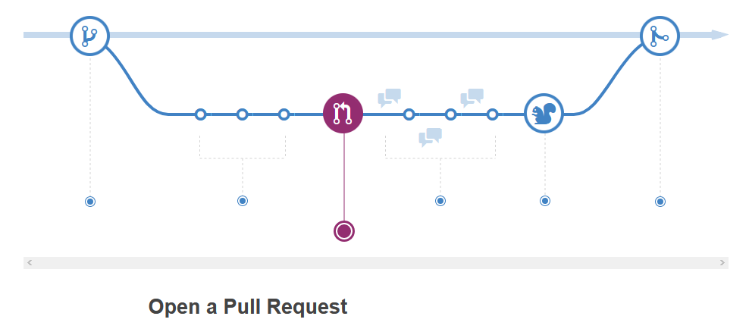
github workflow

Slide 25
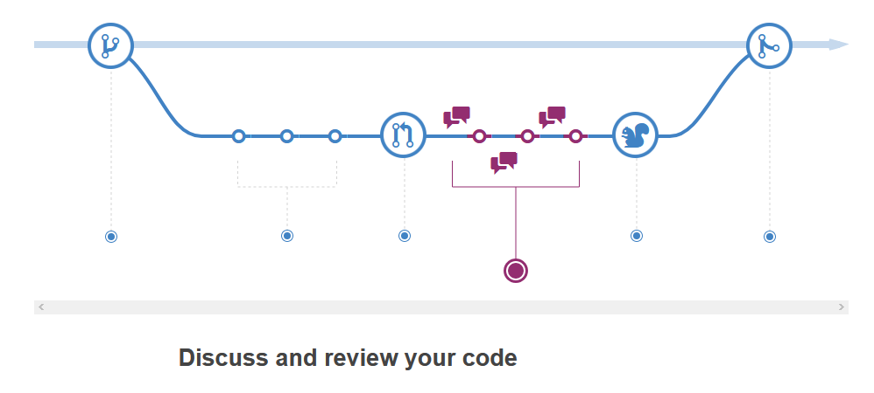
github workflow

Slide 26
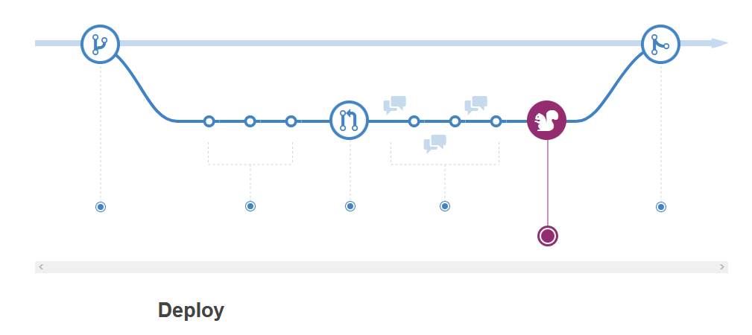
github workflow

Slide 27
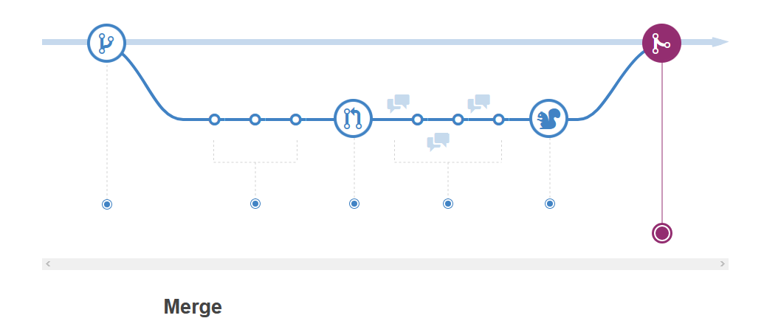
github workflow

Slide 28
Here at GitHub, our developers, writers, and designers use branches for keeping bug fixes and feature work separate from our master (production) branch. When a change is ready, they merge their branch into master.
Ketika ada masalah dalam satu fitur, maka yang diedit adalah branch fitur yang bersangkutan tanpa mengoprek atau merubah branch master, ketika perubahan itu sudah siap. baru dilakukan merge ulang,
https://guides.github.com/

